Slide 1

Banker’s Algorithm
PROBLEM STATEMENT :- 6
Group members
Aditya Vardhan Sharma
Lakshay magotra
Akhilesh sharma
khushi

Slide 2
Problem Statement
To implement the most representative banker’s algorithm for deadlock avoidance

Slide 3
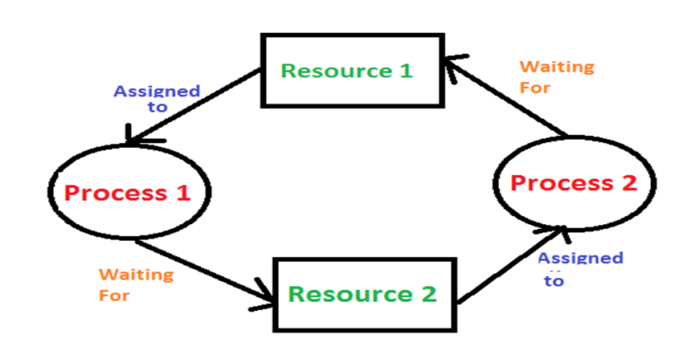
What is Deadlock?
Deadlock is a situation where a set of processes are blocked because each process is holding a resource and waiting for another resource acquired by some other process.
Fig 1.1[1]

Slide 4
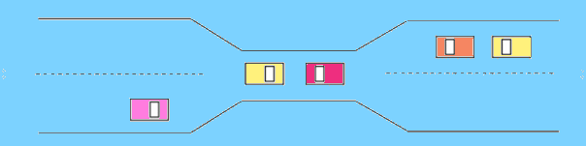
A Real-World Example
A real world example would be traffic, which is going only in one direction.
Here, a bridge is considered a resource.
So, when Deadlock happens, it can be easily resolved if one car backs up.
Several cars may have to be backed up if a deadlock situation occurs.
So starvation is possible.
Fig 1.2[2]

Slide 5
The(3) Conditions for Deadlock
Deadlock can arise if the following four conditions hold simultaneously (Necessary Conditions)
1. Mutual Exclusion
Only one process at a time may use a shared resource (i.e. critical section).
2. Hold and wait
A process may hold allocated resources while awaiting assignment of others.
3. No pre-emption
a resource can be released only voluntarily by the process holding it, after that process holding it, after that process has completed its task

Slide 6
Requirements
Banker’s Algorithm
Linux Operating System
Coding Platform – nano editor or vi editor

Slide 7
Banker’s Algorithm
Banker’s Algorithm is resource allocation and deadlock avoidance algorithm which test all the request made by processes for resource, it checks for the safe state, if after granting request system remains in the safe state it allows the request and if there is no safe state it does not allow the request made by the process.
Inputs to Banker’s Algorithm:
Max need of resources by each process.
Currently, allocated resources by each process.
Max free available resources in the system.
The request will only be granted under the below condition:
If the request made by the process is less than equal to max need to that process.
If the request made by the process is less than equal to the freely available resource in the system.

Slide 8
Pseudo Code: 1. Initialize the available resources array, A, with the number of available instances of each resource. 2. Initialize the maximum resources array, M, with the maximum number of instances of each resource that each process can request. 3. Initialize the allocation matrix, R, with the number of instances of each resource that are currently allocated to each process. 4. Initialize the need matrix, N, with the number of instances of each resource that each process still needs to complete its execution. This can be calculated by subtracting the allocation matrix from the maximum resources array. 5. While there are processes that need resources:

Slide 9
6. Select a process, P, that needs resources.
7. If the resources that P needs are available:
8. Allocate the needed resources to P.
9. Update the available resources array, A, by subtracting the resources allocated
to P.
10. Update the allocation matrix, R, by adding the resources allocated to P.
11. Update the need matrix, N, by subtracting the resources allocated to P.
12. If P has been completed, remove it from the list of processes that need
resources.
13. Else:
14. Go back to step 5 and select a different process.
15. If all processes have been completed, terminate the algorithm.
16. Else, the system is in an unsafe state and the algorithm cannot proceed

Slide 10
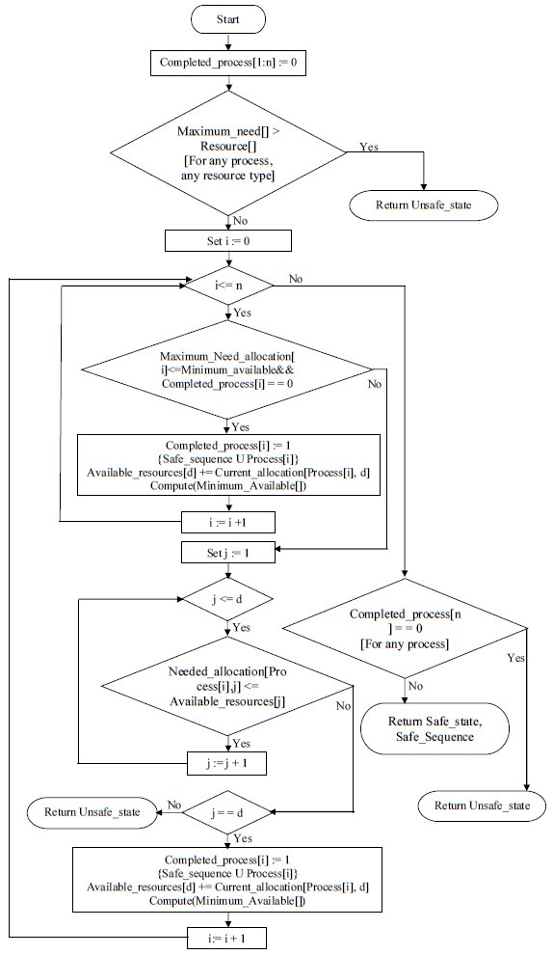
FLOWCHART
fig 1.3[4]

Slide 11
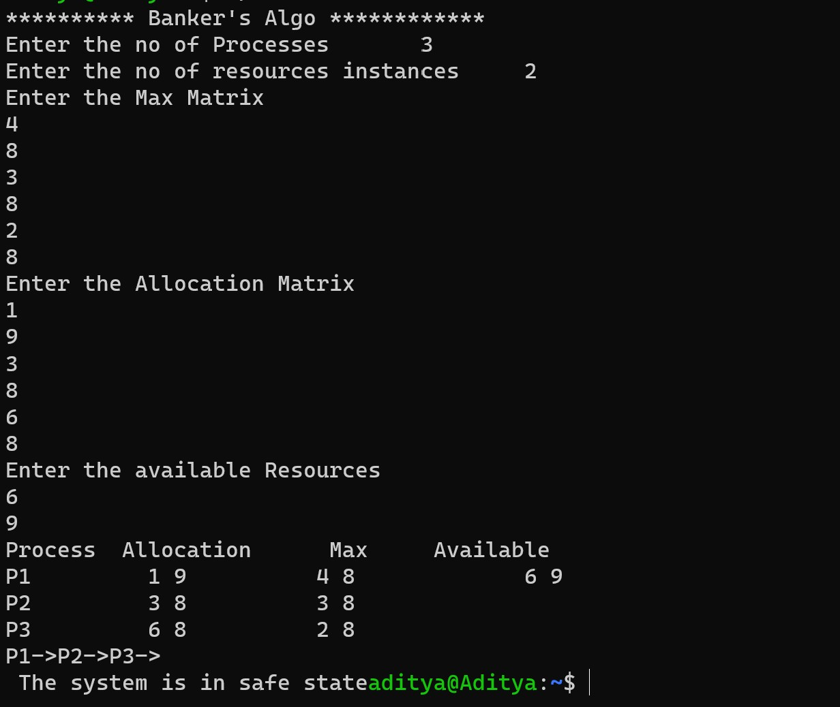
IMPLEMENTATION:
Safe State

Slide 12
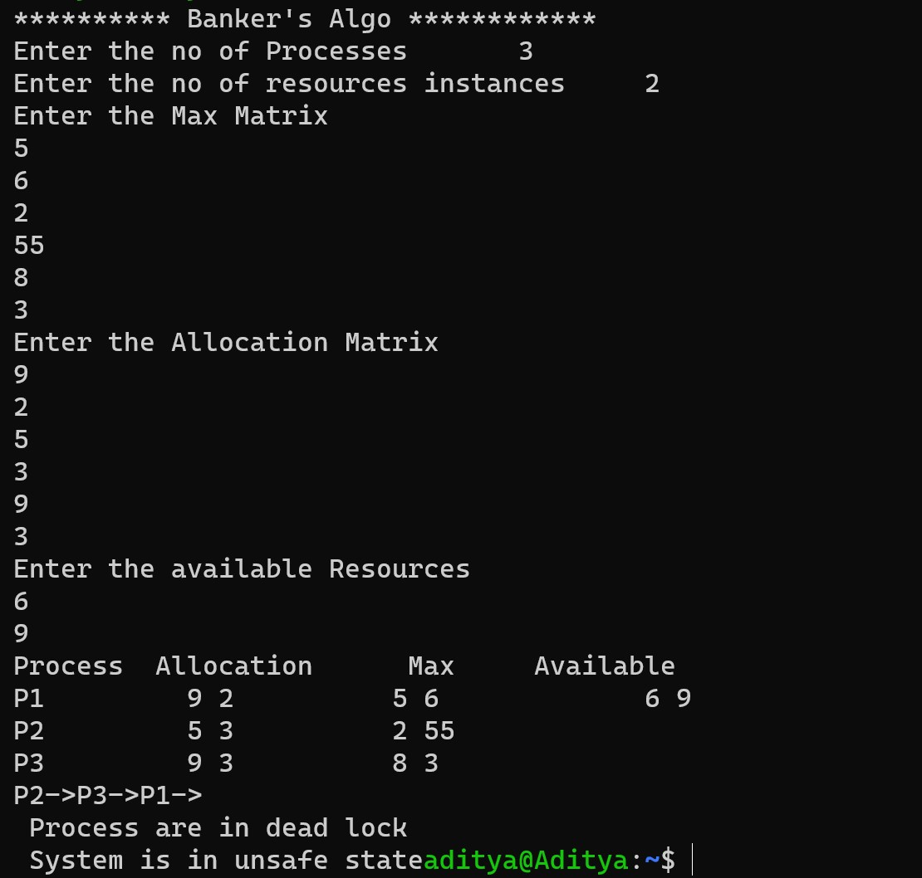
Unsafe Sequence

Slide 13
References:
1 - https://tinyurl.com/2qdzdu2x
2 - https://tinyurl.com/2eb3m9vc
3- Code - http://suraj1693.blogspot.com/2013/11/program-for-bankers-algorithm- for.html
4- www.researchgate.com

Slide 14
THANK YOU

